Slide 1
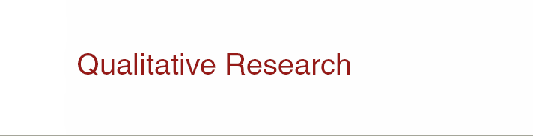


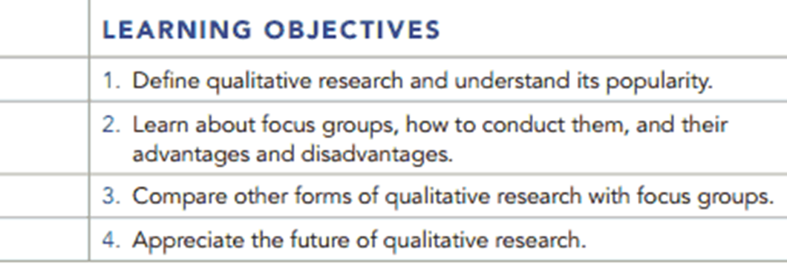
Chapter Five Q and A
5-1

Slide 2
Question
What are the major differences between quantitative and qualitative research?

Slide 3
Answer
Qualitative research is performed using small samples. Its findings are not subject to quantification or quantitative analysis, but are subjectively evaluated. The questions used are probing and require much information from the respondent. Quantitative research is performed using large sample sizes. Its findings are analyzed using statistical methods. Fewer special skills are required to administer quantitative research, and respondents are asked questions that probe on a limited basis.

Slide 4
Question
What are some of the possible disadvantages of using focus groups?

Slide 5
Answer
The immediacy and apparent understandability of focus groups may be misleading. They may be composed of a small sample that is not representative of the population of interest. The type of person recruited may not be a typical customer. The setting may make participants uncomfortable, or the style of the moderator may bias the discussion. Some participants may try to dominate the discussions, which would lead to results that were not representative of the entire group.

Slide 6
Question
Read Case 5.1 – McDonald’s Listening Tour
1. Is the listening tour really qualitative research? Why or why not?
2. After the findings are presented to management, should quantitative research be done?

Slide 7
Question
3. Couldn’t McDonald’s just have done focus groups instead?
4. Besides focus groups, what qualitative techniques might McDonald’s used?

Slide 8
Answer
1. A listening tour infers that the type of information secured is of a qualitative nature. The responses are free-flowing and open-ended, hence, qualitative research.
2. It depends upon the kind of results management gets. If management thinks a quantitative study is need to validate the qualitative results, then it might do one. However, if the preponderance of evidence about McDonald’s is from a broad audience and well defined, a quantitative study may not be necessary.

Slide 9
Answer
3. Focus groups might limit the types or top of mind responses, given McDonald’s appeal is to a very diverse audience.
4. Answers can vary, but a cartoon drawing could ask the respondent to “draw a picture of a typical McDonald’s customer, both adult and child. Story Completion could ask respondents to finish the sentence: the health of McDonald’s patrons who go there at least twice a week is?

Slide 10
Question
Which of the following academic backgrounds would a qualitative researcher most likely have?
Math
Natural sciences
Psychology
Computer sciences
None of these backgrounds are qualified for qualitative research.

Slide 11
Answer
Ans: C

Slide 12
Question
The most common type of qualitative marketing research is _______.
projective techniques
cartoon test
sentence completion
focus groups
none of these

Slide 13
Answer
Ans: D

Slide 14
Question
Which of the following is not an example of a projective test?
a. word association
b. sentence completion
c. cartoon test
d. photo sorts
e. All of these are examples of projective tests.

Slide 15
Answer
Ans: E

Slide 16
Question
32. A word association test is______________.
a. Drawing a comparison between two items in terms of their similarities.
b. Drawing a comparison between a product and a person.
c. A test in which respondents complete sentences or stories in their own words.
d. A test in which the interviewer says a word and the respondent must mention the first thing that comes to mind.

Slide 17
Answer
Ans: D

Slide 18
Question
Distinguish between quantitative and qualitative research, especially with respect to the appropriateness of each.

Slide 19
Answer
Ans: Exhibit 5.1 in the textbook distinguishes between qualitative and quantitative research with qualitative research being more appropriate in the exploratory stages of a project when insights and not quantification is needed. Later, if the project is descriptive in nature, and the goal is to get a representative response, quantitative research is more appropriate.

